Slide 1

Visualizing and Analyzing COVID-19
Nafees Mahmood & Shemon Rawat

Slide 2
Introduction
The world is currently facing the worst pandemic in recent history, the coronavirus or Covid-19.
It is affecting the whole world in many different ways.
This project serves to provide a visualization and analysis of the situation.

Slide 3
Data Collection
Data set is from January 22nd to April 17th.
Data collection is very hard as the pandemic is a current phenomenon.
Data depends on number of people tested for the disease.

Slide 4
Technologies used
Tableu, a data visualization application that takes as input a data set and outputs different types of visual data.
HTML
JavaScript

Slide 5
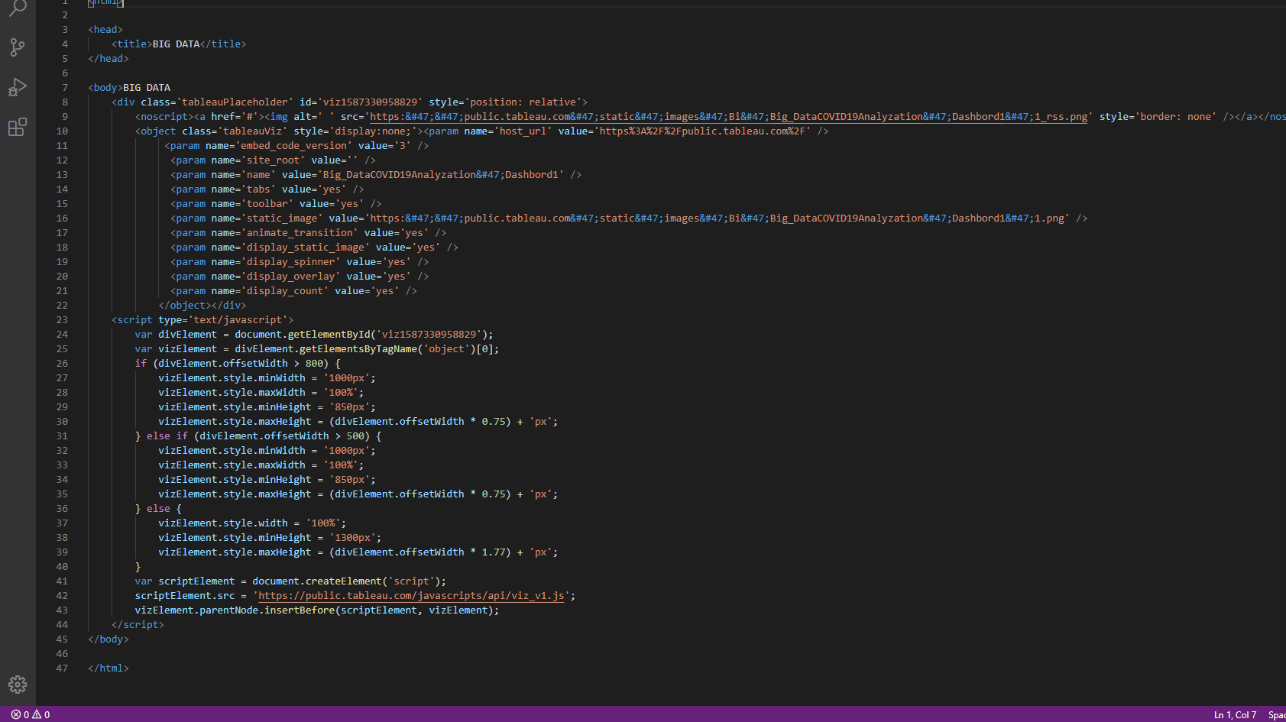
HTML CODE

Slide 6
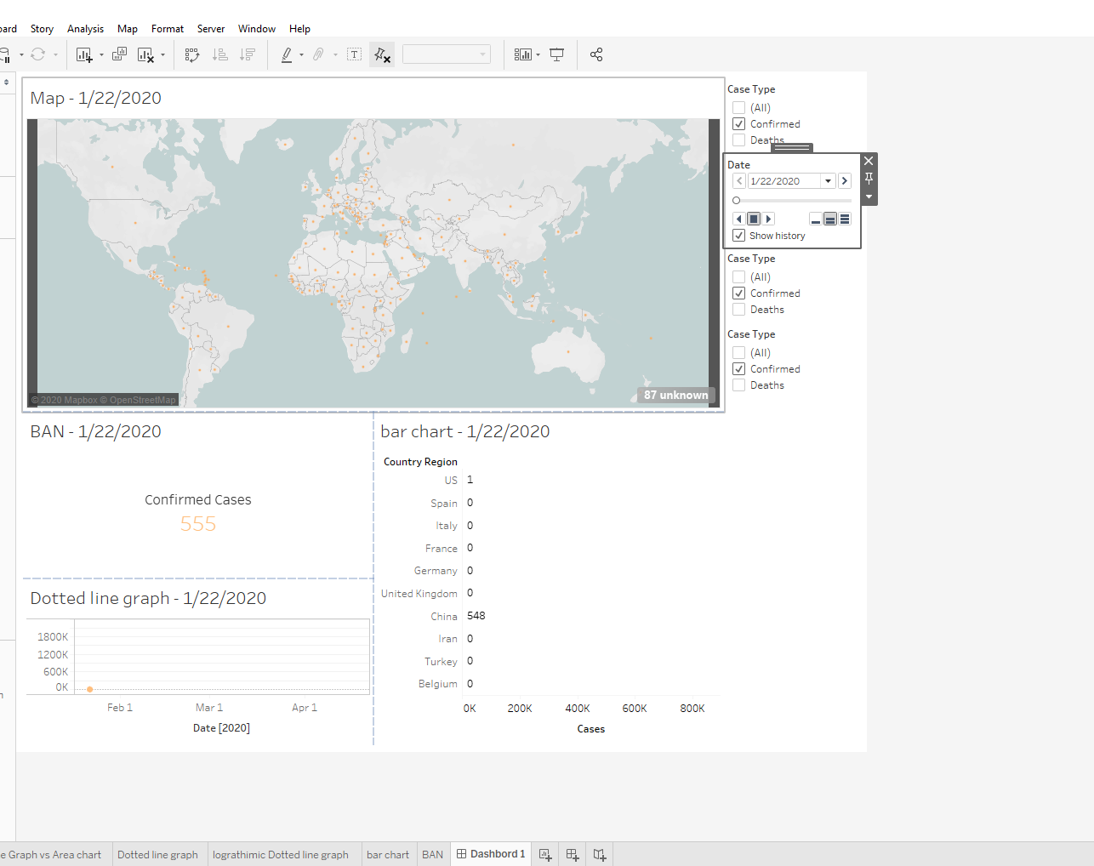
Tableau Dashboard 1

Slide 7
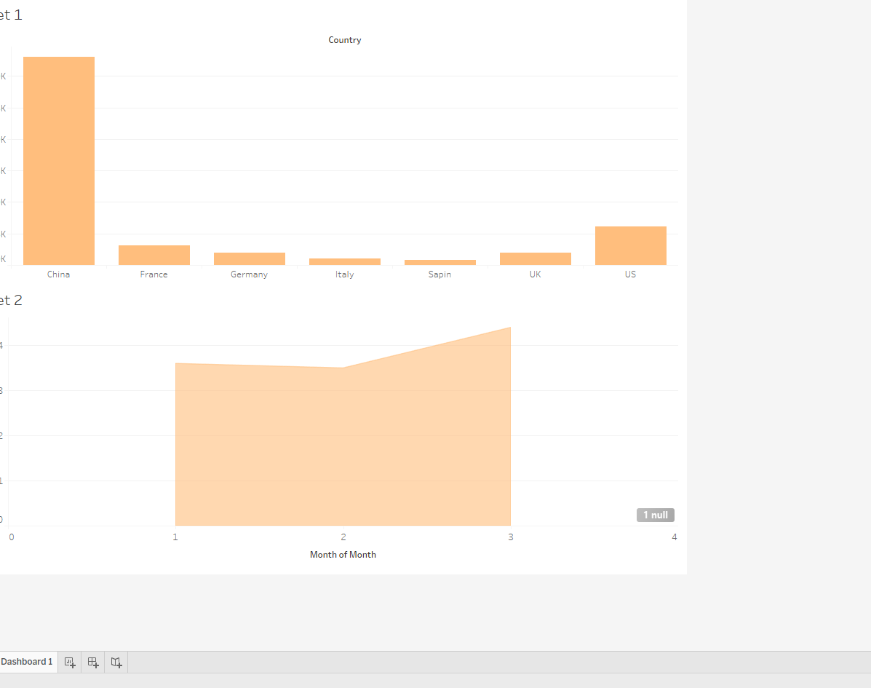
Tableau Dashboard 2

Slide 8
Analysis
Medicare System
As we can see the greatest number of corona virus cases on April 17, 2020 in united states was 699,554 and other countries have significantly lower number of cases of confirmed cases. This could be due to health care system.
Detailed Analysis in the report.

Slide 9
Analysis
Unemployment
The Unemployment rate due to corona virus shot up significantly.
Stimulus Cheque
Detailed Analysis in the report.

Slide 10
Analysis
Business Loss
Unemployment Rate Shot up due to fewer job opportunity.
Detailed Analysis in the report.

Slide 11
Analysis
Climate and AQI(Air quality index)
Personal prediction about climatic changes as Flu and virus tend to peak in colder climate and slow down during summer.
Detailed Analysis in the report.

Slide 12
Working Links
We have a link for our project up and running.
https://public.tableau.com/profile/shemon.rawat#!/vizhome/Big_DataCOVID19Analyzation/barchart

Slide 13
References
https://data.bls.gov/timeseries/LNS14000000
https://data.world/covid-19-data-resource-hub/covid-19-case-counts
https://data.world/cms/hospital-general-information
https://www.statista.com/
https://public.tableau.com/en-gb/gallery/new-delhi-air-quality-index
https://fred.stlouisfed.org/

